Slide 1
Principles of Drug Discovery
Lecture 6: Knowledge-based Approaches
Notes:
6/19/17
1
1

Slide 2
There is a plethora of substances for which it is known that they possess pharmacological activity
For many of these substances pharmacological activity has been known long before there chemical structure or the receptors they act on were revealed. Typical examples are:
Extracts from plants for medical or stimulating use
Toxins derived from plants and animals
With the onset of chemical and biological sciences also many substances were discovered which are needed by living organisms for various functions and for which specialized receptors exist. This type of compounds are known as endogenous ligands. Examples are:
Neurotransmitters
Hormones
In addition biological chemistry and medicinal chemistry have discovered and synthesized millions of compounds over the last century. For many of them it is known that they act on specific receptors, enzymes or other potentially interesting targets and this information is available in public databases, scientific publications or patents.

Slide 3
Early medicinal chemistry was to a large extend based on the knowledge of the pharmacological effect of a certain substance and then to systematically synthesize close analogs in order improve properties and activity.
Heroin
Synthetic derivative of morphine
Morphine
Natural product from the opium poppy
Knowledge-based: Start from a known pharmacologically active substance

Slide 4
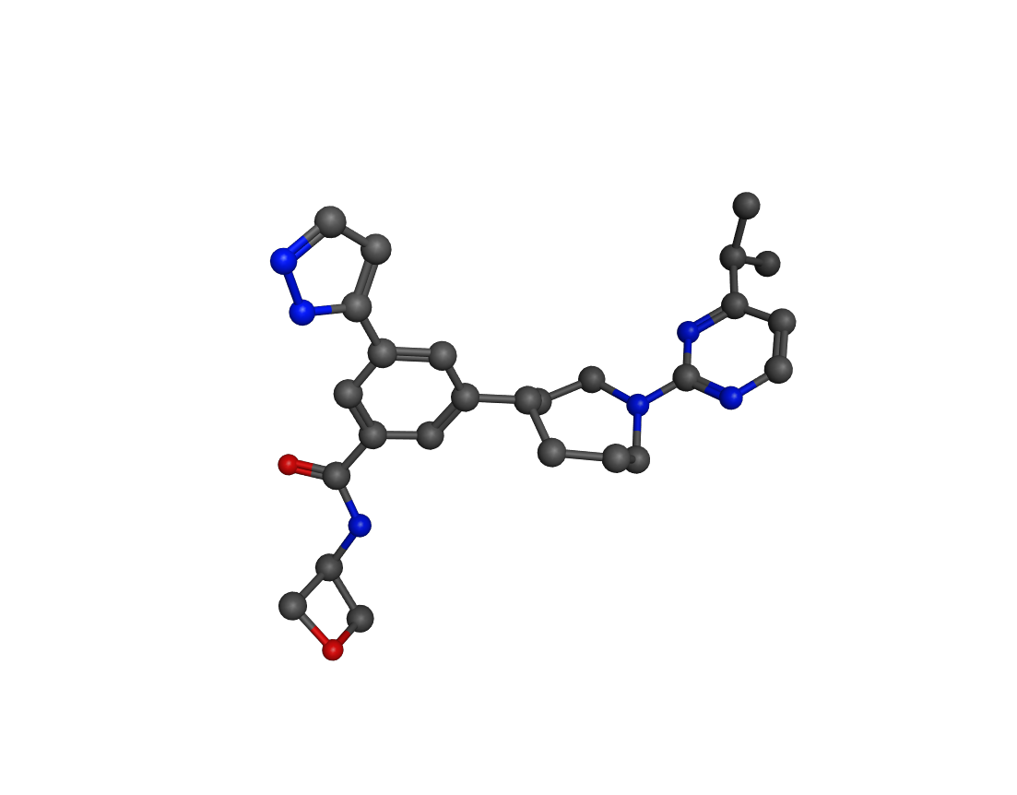
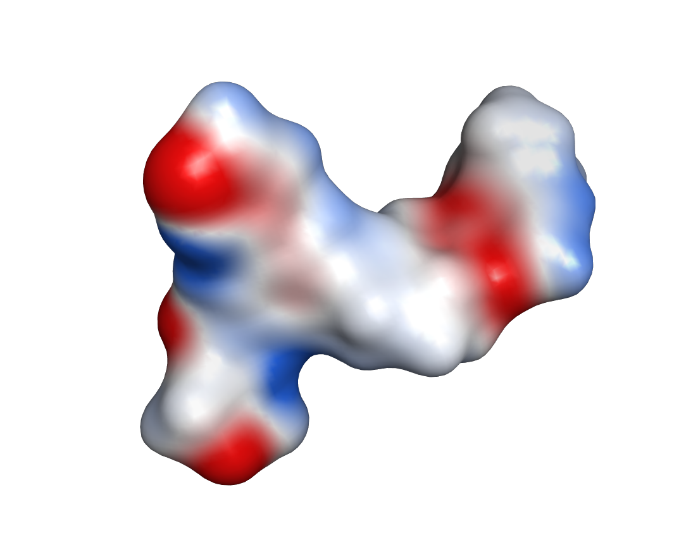
The biological activity of a molecule is encoded in it’s three-dimensional structure, which determines:
The shape
The relative spatial orientation of different chemical groups
What kind of interactions with a receptor are possible

Slide 5
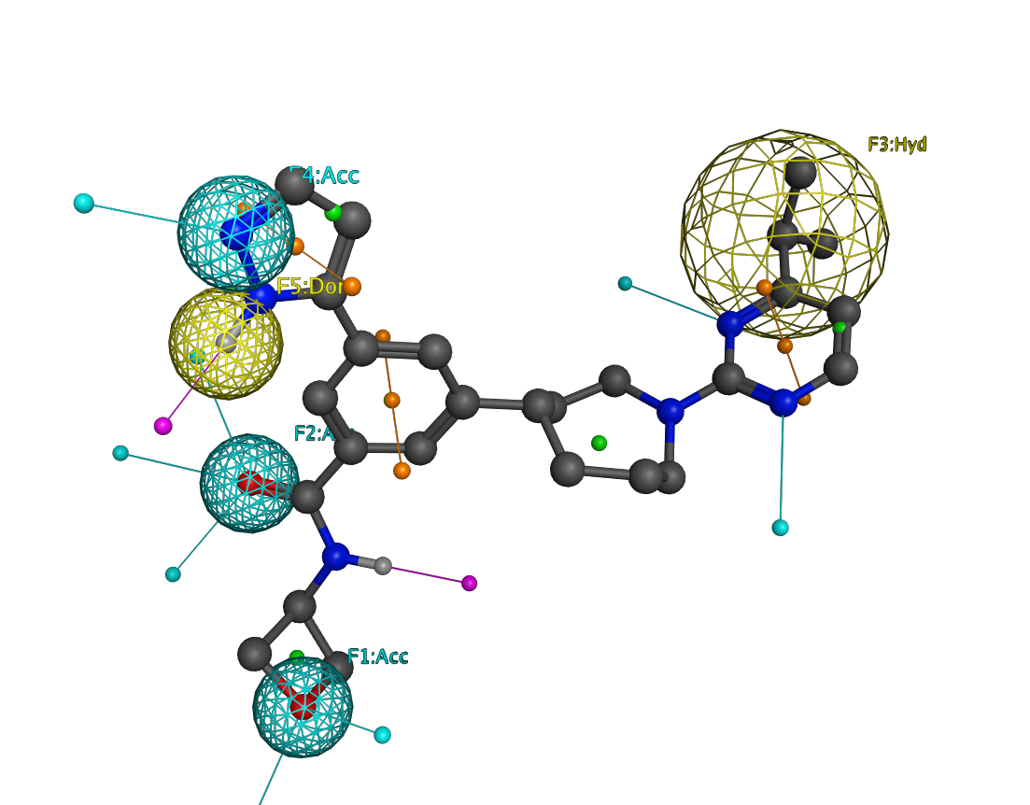
As we have already seen with the analysis of screening hits is that active molecules often share common features, they are similar.
Often few key interactions in the correct spatial arrangement are sufficient for activity on a given target.
Such a spatial arrangement of chemical features which are important for activity is called a pharmacophore.
A pharmacophore (ph4) model is the result of a structure-activity-relationship (SAR) analysis

Slide 6
Change of acceptor to donor
Linker modification:
neutral if ph4 is unchanged
Change non-polar to polar group
Modification of pharmacophore points to chemical groups with different properties usually leads to an affinity drop.
Change of donor/acceptor positions
Modification in region which is not part of the ph4.

Slide 7
Dopamine
Dopamine is a neurotransmitter which is important for brain function. There are specific receptors (D1-D5) which recognize dopamine, a specialized transporter (DAT) which is responsible for dopamine re-uptake as well as specialized enzymes for dopamine production and degradation.
Dysregulation of the dopamine system can lead to severe moving disorders (Parkinson, lack of dopamine) or, in the case of hyper-activity, to mood elevation up to psychotic symptoms (Schizophrenia).
The dopamine system has therefore been an extensive field of research.
Chemical synapse

Slide 8
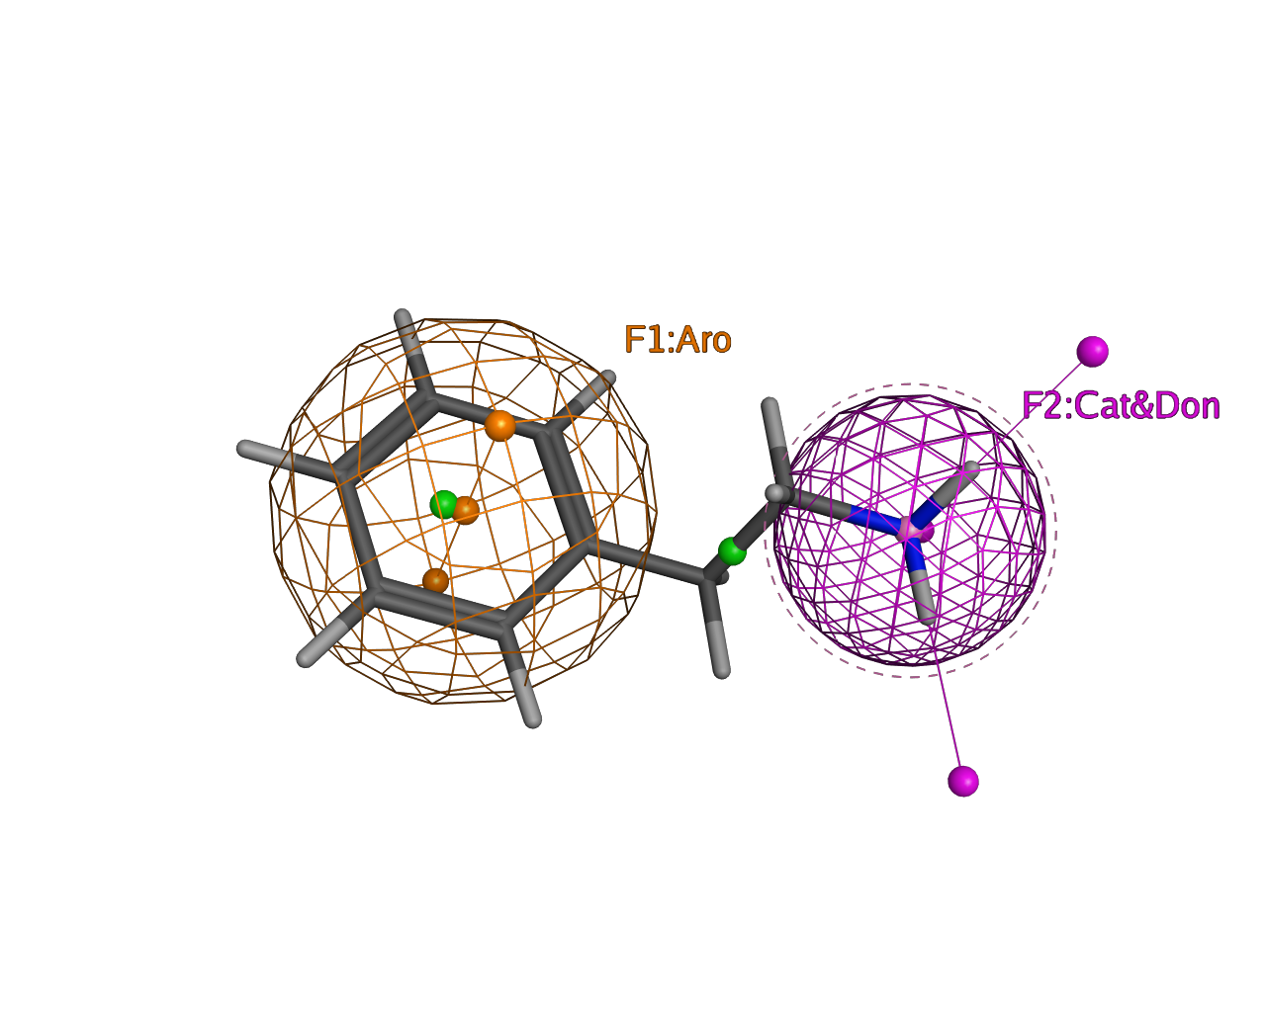
Phenyl-Ethylamines
Amphetamine
(Treatment of ADHS, Obesity)
Phenylethylamine
(chocolate)
Dopamine
Methamphetamine
(Pervitin, Speed, Crystal Meth)
Mescaline (peyote cactus)
Pharmacophore
Natural products
These natural and synthetic dopamine analogs act as agonists on dopamine receptors.
Ecstasy
Synthetic products

Slide 9
Phenyl-Ethylamines
Epinephrine is also a close homolog of dopamine but it acts on a different types of receptors, so-called adrenergic receptors.
Adrenoreceptors are important for blood pressure regulation, contraction and relaxation of smooth muscles.
Dopamine
Epinephrine (Adrenaline)
Ephedrine (different plants)
Salbutamol
(anti asthmatic)
Propranolol
(beta-blocker)
Agonist
Antagonist

Slide 10
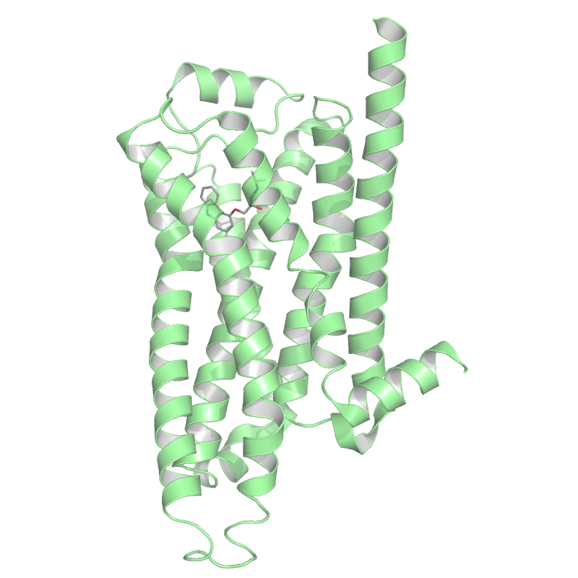
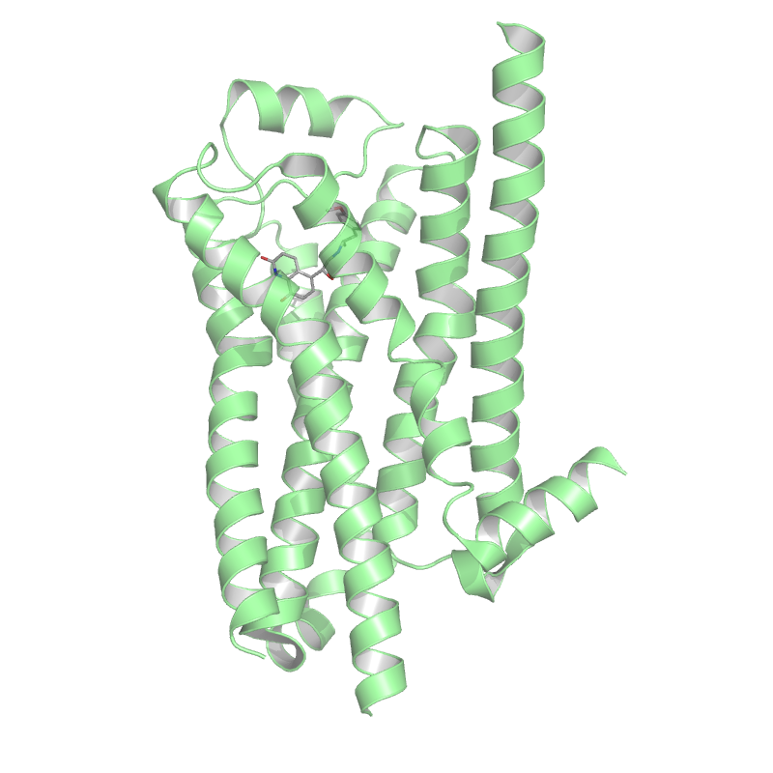
Inactive conformation
Active conformation
Agonist
Antagonist
Small chemical modifications can turn an antagonist into an agonist and vice versa

Slide 11
Acetylcholine
Muscarine (mushrooms)/Agonist at muscarinic ACh-Receptors (GPCR)
Acetylcholine is a neurotransmitter important for memory, attention but also for smooth muscle contraction.
ACh act on different receptor types like ion channels (nicotinic acetylcholine receptor) or GPCRs (muscarinic acetylcholine receptors).
Antropine(belladonna)/Antagonist at muscarinic ACh-Receptor
Nicotine(tobacco)
Agonist at nAChR (Ion Channel)

Slide 12
Anticholinergics exhibit a bronchodilatory effect via reduction of smooth muscle contraction in the airways.
Atropine
Ipratropium®
Tiotropium®
While the natural products Atropine and Scopolamine have substantial effects on the central nervous system due to brain permeation, the synthetic quartenary ammonium variants do not cross the blood brain barrier. They are used for the treatment of Asthma and COPD.
Scopolamine
(angle’s trumpets)

Slide 13
Piperoxan
(α-adrenergic blocking agent)
Compound 929
(antihistamine)
Compound F1571
(antihistamine)
Promethazine, Fenergan®
(antihistamine)
Phenbenzamine, Antergan®
(antihistamine)

Slide 14
Promethazine, Fenergan®
(antihistamine)
Promazine
(neuroleptic)
Chlorpromazine, Thorazine®
(neuroleptic)

Slide 15
Promazine
(neuroleptic)
Imipramine
(antidepressant)
Amitryptiline
(antidepressant)
Loratadine®
(antihistamine)
Cyproheptadiene,Periactin®
(antihistamine)

Slide 16
Many endogenous ligands are small molecules with a simple (and overlapping) pharmacophore.
Acetylcholine
Dopamine
Serotonine
Histamine
This is the reason why many medicinal chemistry efforts based on neurotransmitters accidentally lead to compounds with unexpected pharmacologic properties.
Most of the drugs discovered this way are active on a multitude of different receptors partly with agonistic or antagonistic effects.
However, many of the drugs discovered in the 50s and 60s of the last century are still on the WHO list of essential medicines.

Slide 17
A known bioactive compound can serve as a template for new compounds
The probability that a modified compound is still active is higher if the pharmacophore remains intact
There are two strategies to achieve this:
Replacement of molecule parts which do not interact with the receptor with building blocks that ensure that the pharmacophore points are still in the correct spatial arrangement
Replacement of interacting groups with groups which are able to form the same or similar interactions

Slide 18
Bioisosteres
Bioisosteric replacements result in molecules which have:
A similar overall geometry
A similar spatial demand
A similar 3D-arrangment of pharmacophore points
≈
≈
Simple bioisosteric replacements:
≈
≈
≈
≈
≈
≈

Slide 19
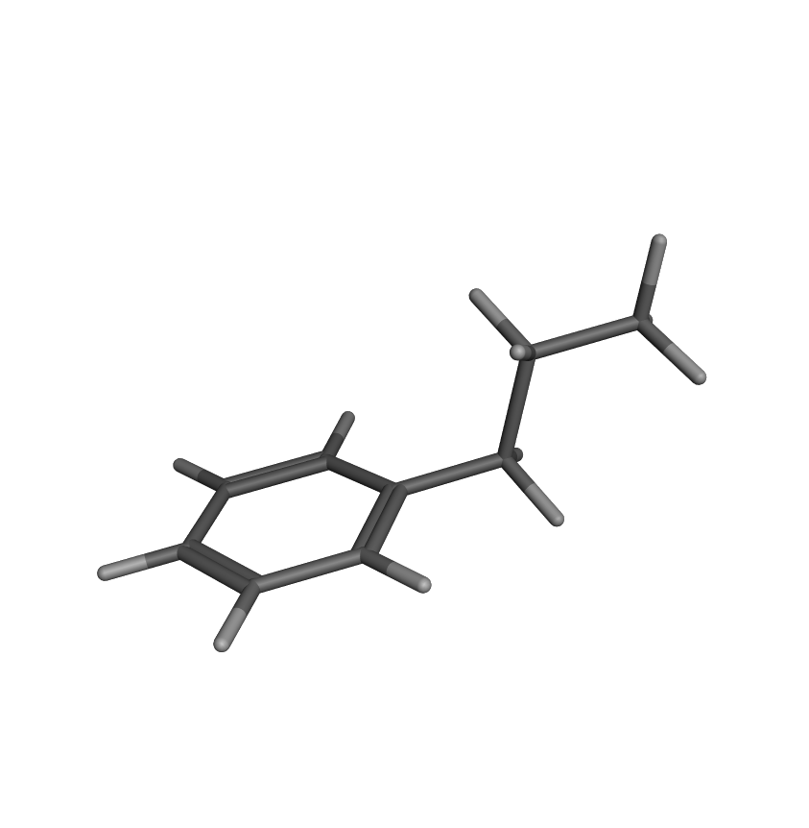
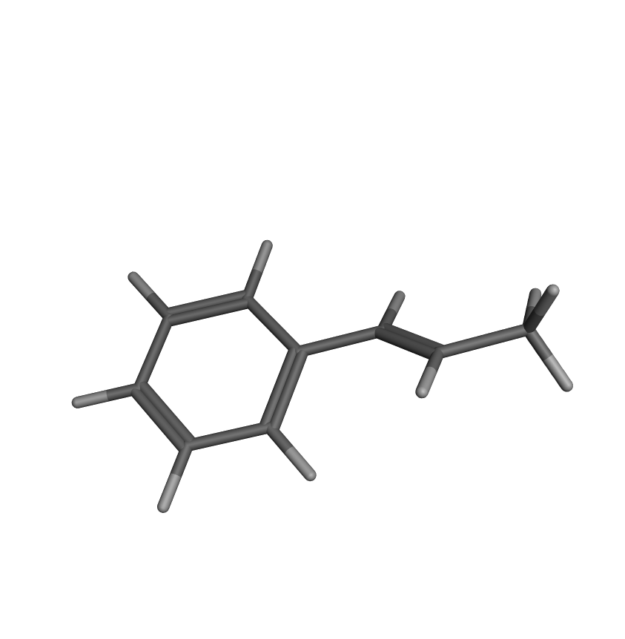
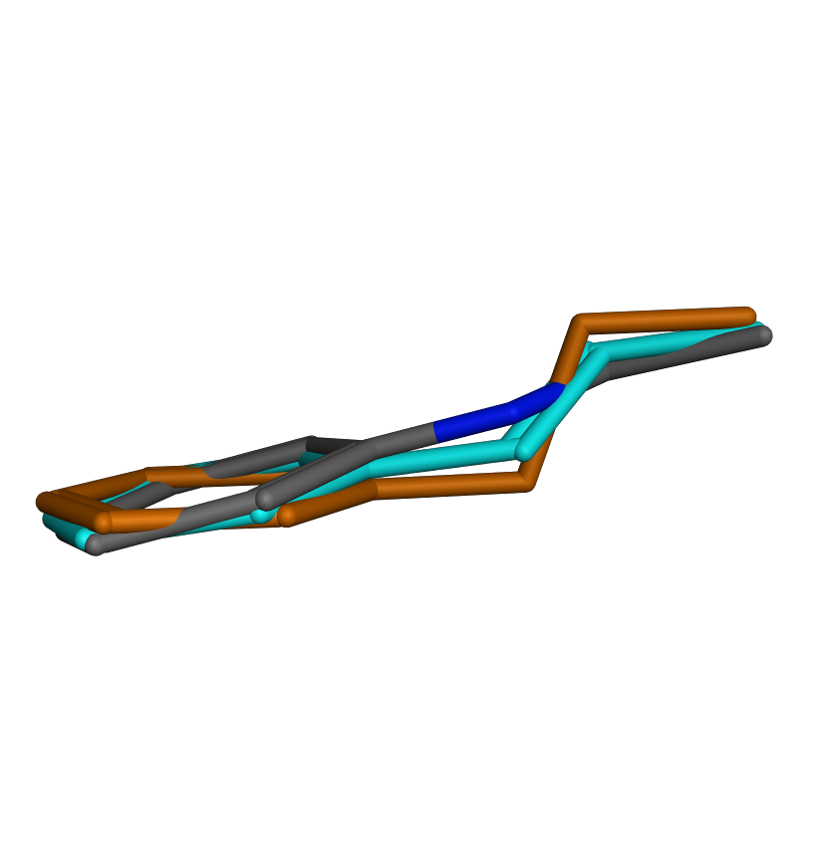
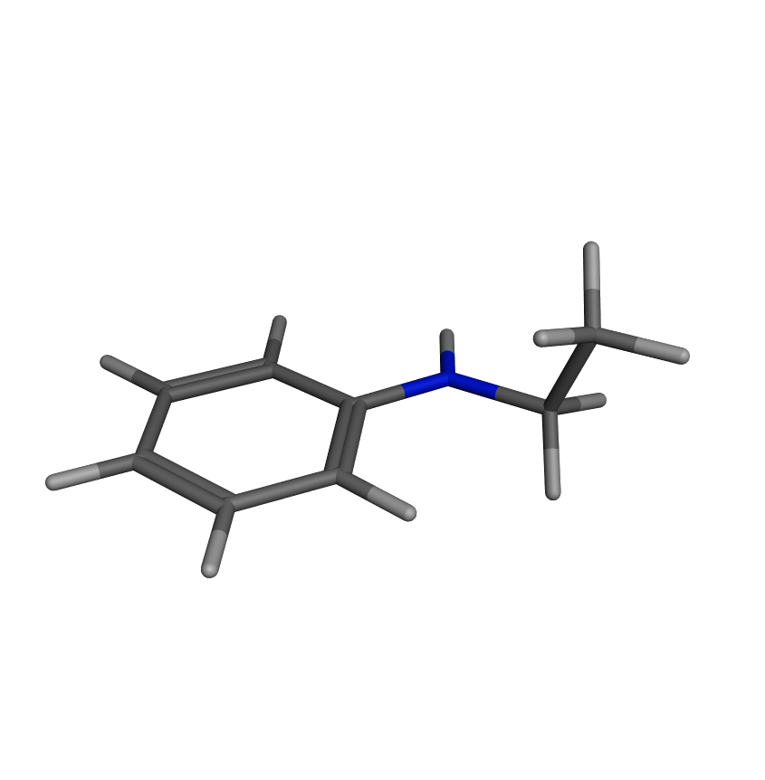
Changes result in an altered molecule geometry. Sometimes this is tolerated, sometimes not.
Amitryptiline
Imipramine

Slide 20
Carboxylic acid bioisosteres
Irbesartan
Telmisartan
Azilsartan
Losartan
Angiotensin II receptor antagonists (treatment of hypertension)

Slide 21
Amide Bioisosteres
Carbamate
Ester
Urea
Amide
Sulfonamide
Lactam
Cyclic urea
Alcohol

Slide 22
Amide Bioisosteres
Amide

Slide 23
Ring-closures and
heteroatom shifts in rings
Sildenafil, Viagra®
Vardenafil, Levitra®

Slide 24
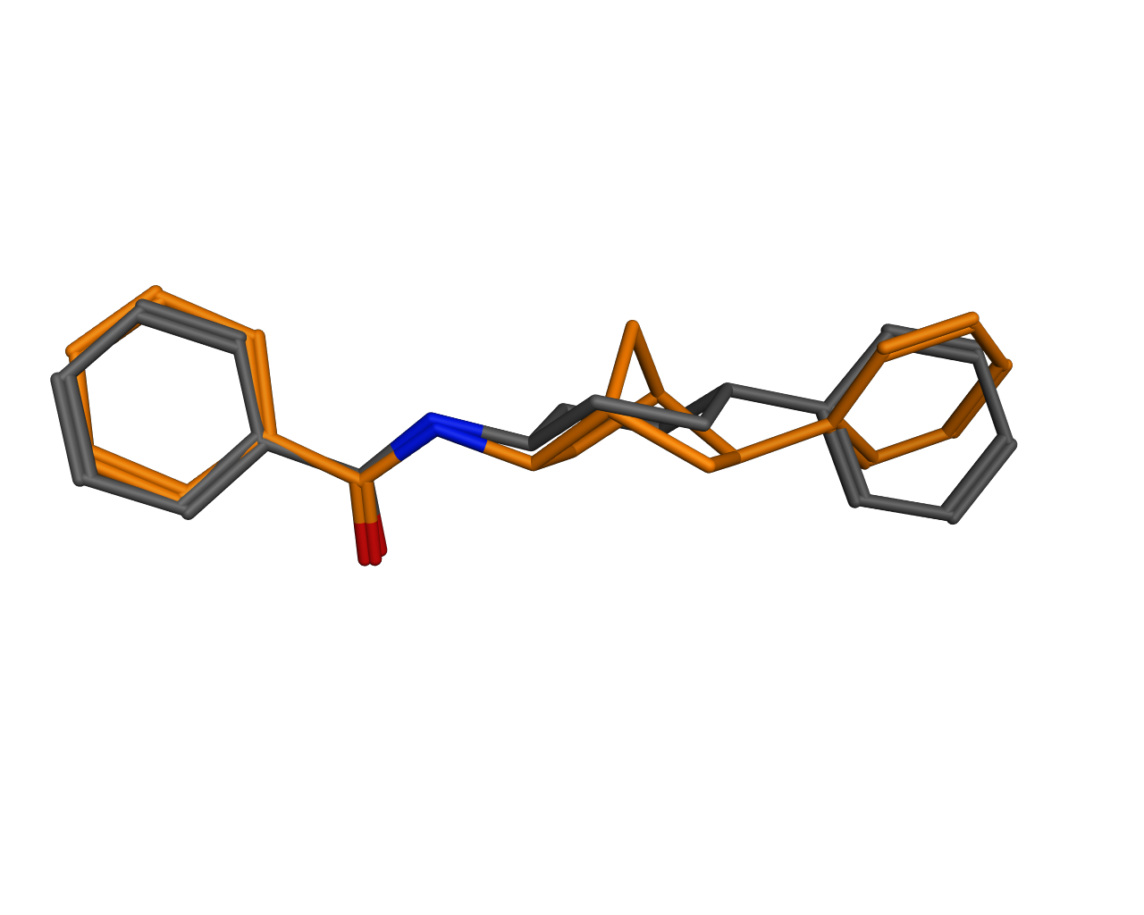
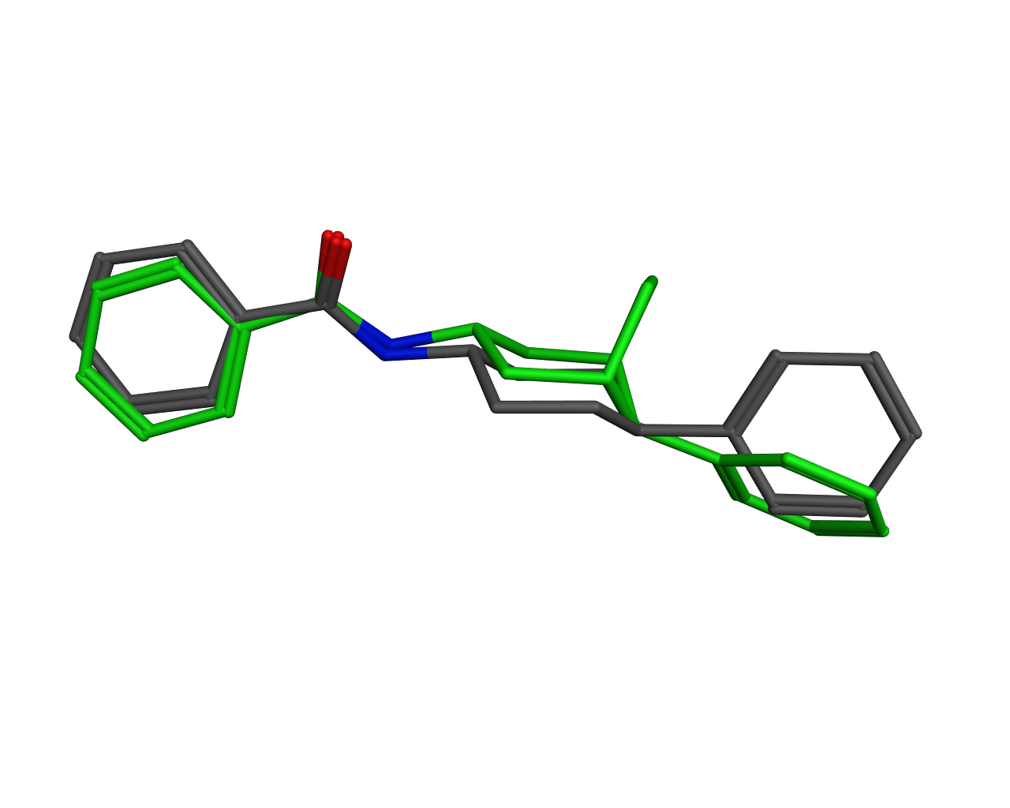
Variations of aliphatic ring systems
Changing cyclohexyl into bicyclo[2.2.1]heptane causes switch to boat conformation. Inversion of stereocenter restores molecule geometry.
Ring position changes due to steric repulsion

Slide 25
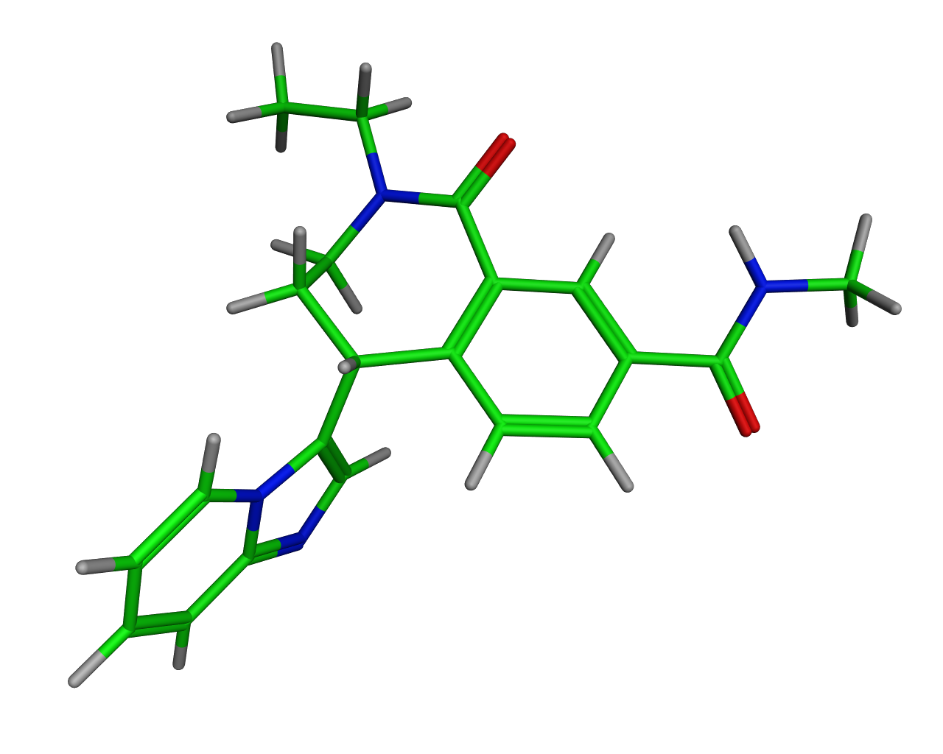
Bioisostere replacement of the central molecule parts are quite difficult, especially if the core already has a complex 3D structure
Flat core
3D core
Replacement of a core with an alternative one which puts the exit vectors into the same orientation is called scaffold replacement or scaffold hopping.

Slide 26
Learnings so far:
The spatial arrangement of structural motifs which are important for binding to the target are called pharmacophore
To find new molecules which bind to the target we can either replace interacting groups with moieties which are able to form the same interactions with the target or
We can replace the core (scaffold) of the molecule in a way that the interacting groups will afterwards be oriented in the same direction.

Slide 27
Modification of active molecules while retaining or improving activity is a daily business of medicinal chemists throughout a drug discovery program
For the purpose of hit finding based on an active molecules also a variety of computational methods have been developed
Pharmacophore searches
Fingerprint-based similarity searches
Graph-based similarity searches
Shape-based similarity searches

Slide 28
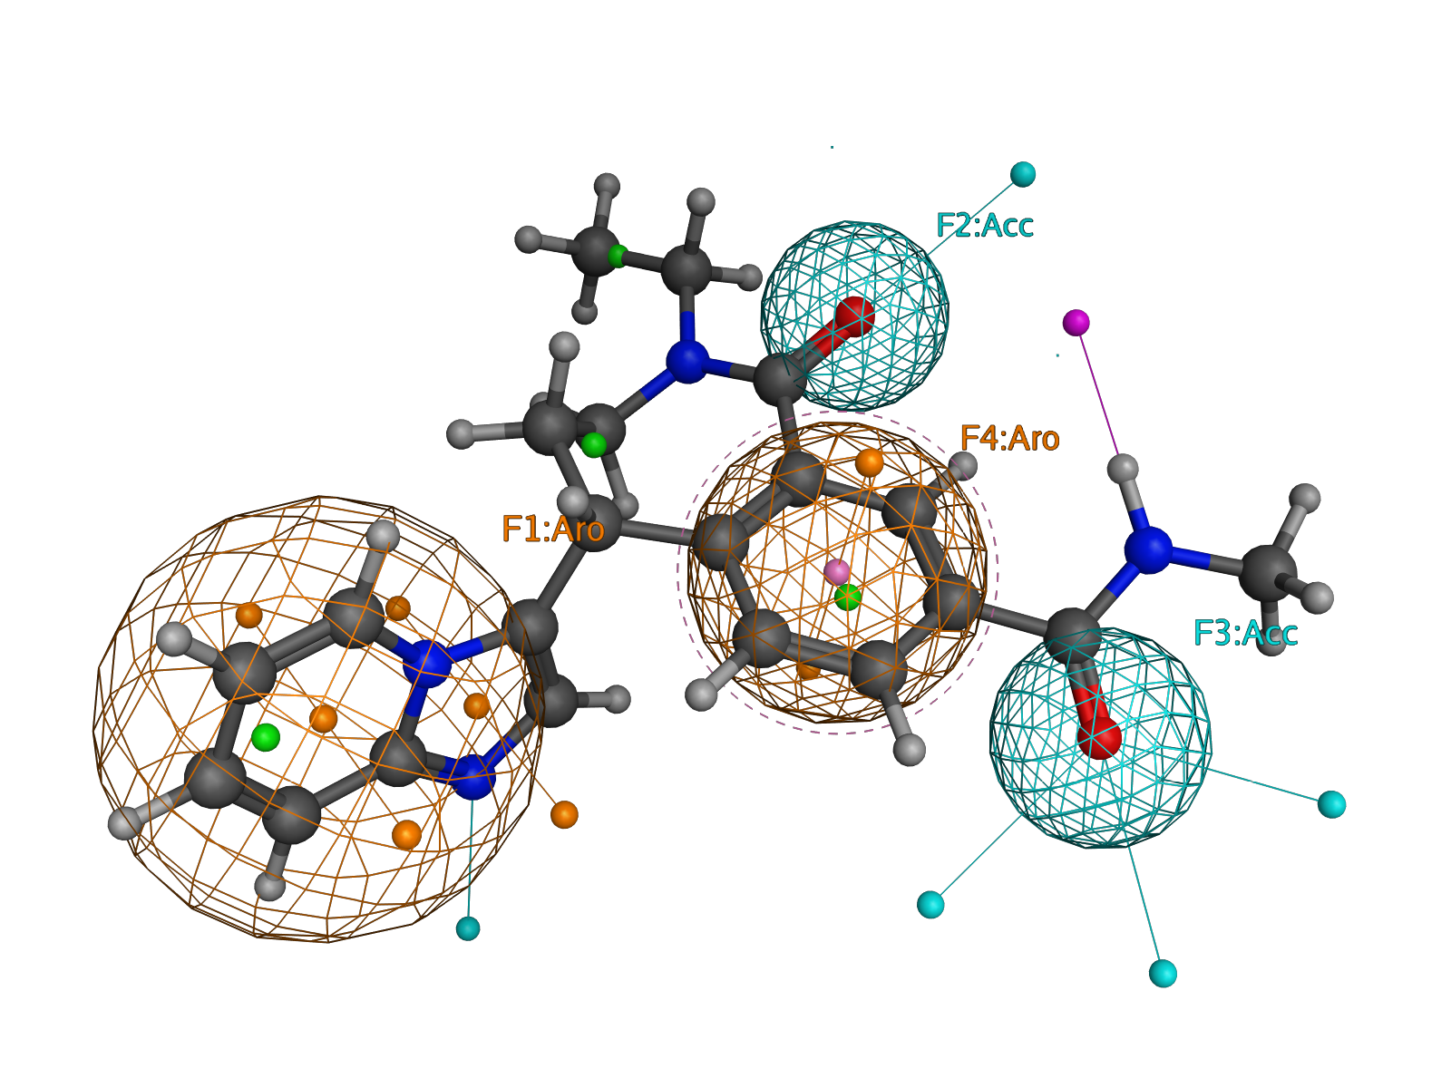
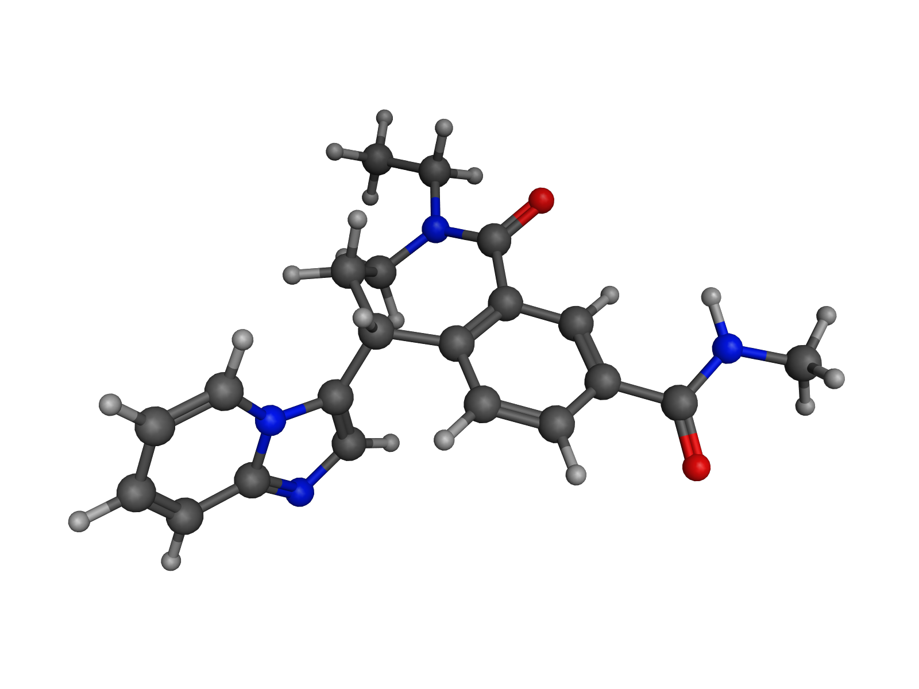
Search template
Pharmacophore with two aryl and two donor
positions
Molecule Database

Slide 29
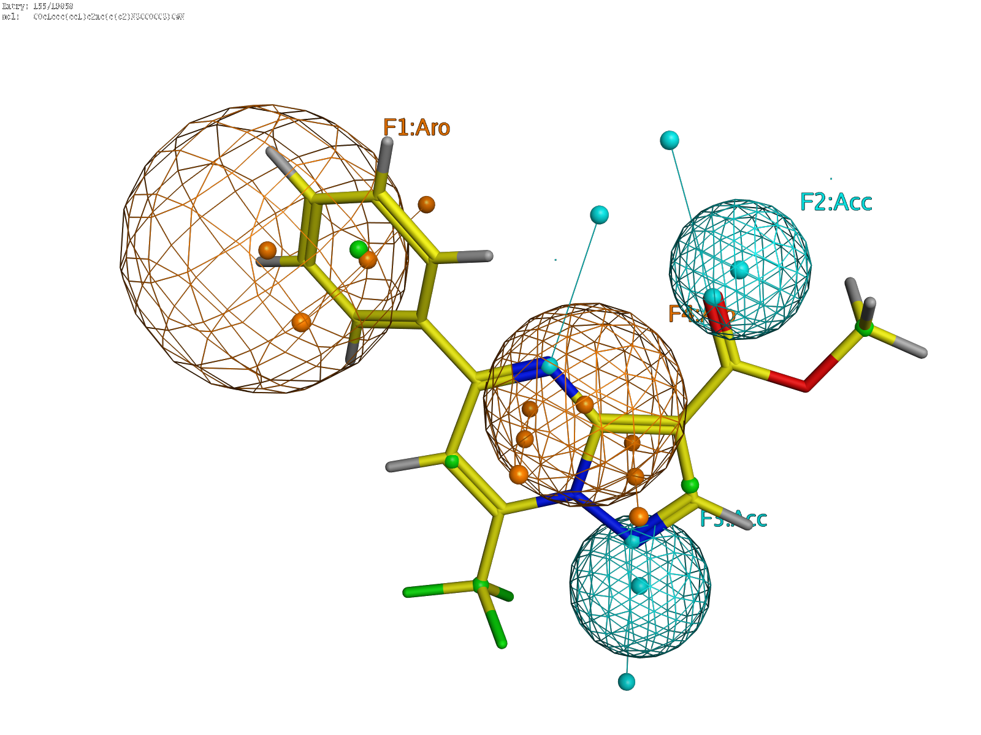
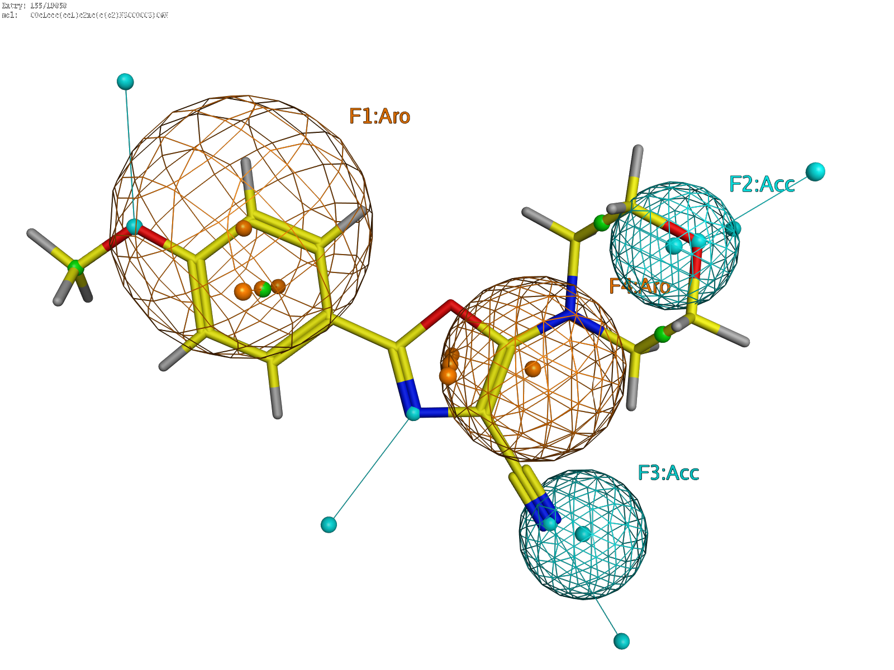
Results of a pharmacophore search
The matching molecules can be totally different to the query except for the pharmacophore points they match.

Slide 30
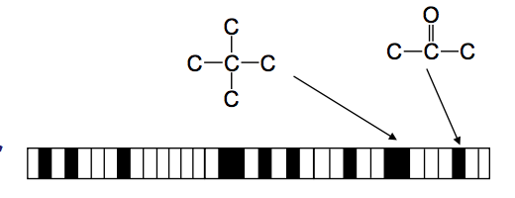
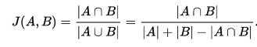
Fingerprint-based similarity search
A fingerprint is a binary vector where each bit represents a substructure pattern
Each element (bit) can either be ”1” if the pattern is present in a molecule or ”0” if it is not.
The similarity between two bit vectors can be computed by the so-called Jaccard (Tanimoto) index
Its value is 1 for identical fingerprints and 0 for completely different fingerprints
Its computation is very fast and commonly employed to compute similarities between large sets of molecules

Slide 31
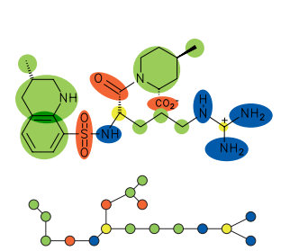
Graph-based similarity search (Feature Trees)
Molecules are abstracted into a simplified graph representation where the different nodes represent different atom or substructure types. The edges represent the connectivity of the molecule.
Graphs can be very quickly matched against each other such that large database can be searched in short time.

Slide 32
Shape-based similarity search
Shape-based similarity searches take the 3-dimensional structure of a molecule into account.
In contrast to 2D searches this requires information of the bioactive conformation of the query molecule
Shape-based similarity searches are much slower since
The similarity computation is more complex
The query molecule has to be matched against many possible conformations of each molecule in the database

Slide 33
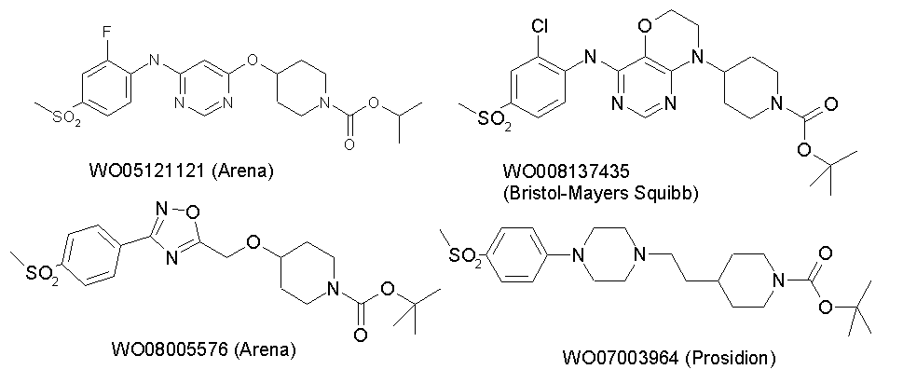
Examples for shape-based searches
Query molecules from competitor patents

Slide 34
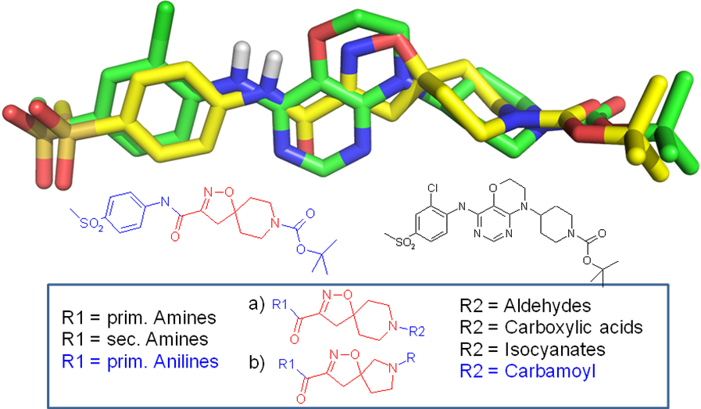

Slide 35
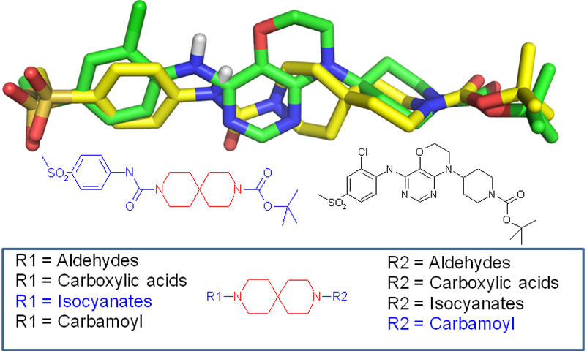

Slide 36
Which molecule databases to search?
Vendors:
Public Databases:
Inhouse Database
These are all collections of molecules which exist and, in the case of inhouse or vendor catalogs, are available or can be purchased.

Slide 37
In addition to existing molecules ligand-based virtual screenings can also be performed in virtual compound collections.
What is a useful virtual compound collection?
This molecule might be a valid molecule but its synthesis is certainly somewhat tricky…….
If we would find such a molecule as a hit in a virtual screening we would certainly not synthesize it. Chances that hits from virtual screenings are active are not very high.
Synthetic accessibility is a key prerequisite for a useful virtual library.

Slide 38
Construction of virtual compound collections
Choose a number of well-established chemical reactions which ideally work in a combinatorial/parallel synthesis setting
Reagents
Amide coupling
Acids, esters + amines
Suzuki coupling
Aryl-halogens + boronic acids
Reductive amination
Aldehydes + amines

Slide 39
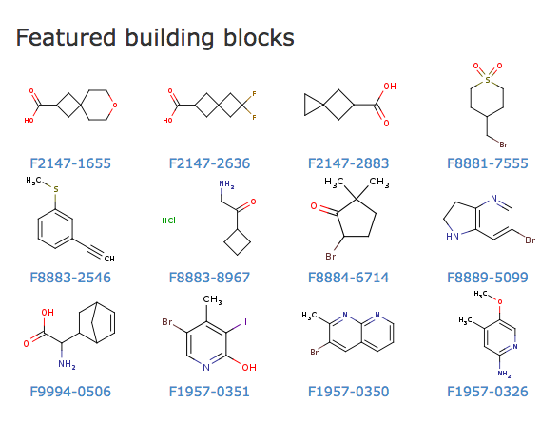
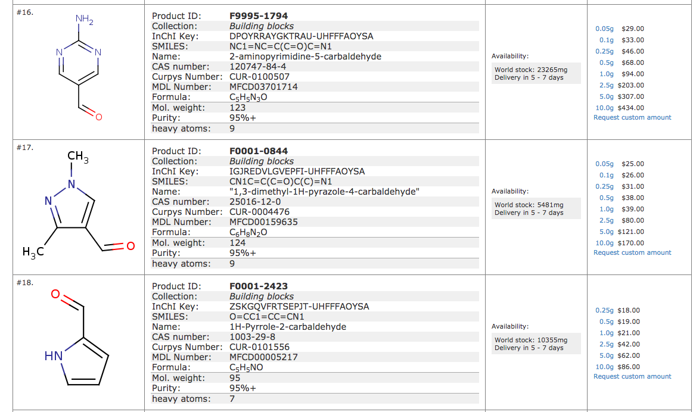
Select reagents which can be used for specific reactions
Online shop for chemical building blocks
There is a whole industry of specialized vendors which offer building blocks.
List of available aldehydes from a vendor catalog

Slide 40
Building blocks with 2 or more exit vectors
Building blocks with 1 exit vector
Decoration
Cores may also be used as decoration for other cores
Cores/Scaffolds

Slide 41
Each scaffold can theoretically be decorated with thousands of reagents at each exit vector
Suzuki Coupling (boronic acids)
Buchwald-Hartwig (anilines, amines)
Core
Amid-coupling
amines
anilines
BI in house
prim Amines (4000)
prim. Anilines (3500)
sec. Amines (6000)
sec. Anilines (2000)
boronic acids (2500)
Millions of possible combinations for each core.

Slide 42
With a limited number of well-established chemical reactions huge virtual libraries can be constructed
The virtual chemical space can be searched with different algorithms
Each hit which is found in the virtual library can be synthesized with few synthetic steps which allows rapid exploration in the lab
Screening Library
HTS
~10⁶
Virtual library of synthetically accessible compounds
~ 10¹⁴
Virtual
Screening

Slide 43
Knowledge-based approaches for hit finding
Starting from a known bioactive molecule (endogenous ligand, natural product, literature, patents) new leads can be obtained by:
Synthesizing close analogs of the template
Make bioisostere replacements at important interaction sites
Adrenaline
Salbutamol
Telmisartan
Losartan

Slide 44
Bioisostere replacement of the molecule core
Sildenafil, Viagra®
Vardenafil, Levitra®
A multitude of computational methods which are based on different molecular similarity algorithms

Slide 45
In drug discovery programs usually all approaches are used in combination
HTS
Bioisostere variations
Ligand-based virtual screening
FBS
Testing
Parallel synthesis of selected scaffolds+decorations
Selection from compound collections
Structure-based virtual screening
Testing
Analyze data and combine best approaches

